Slide 1
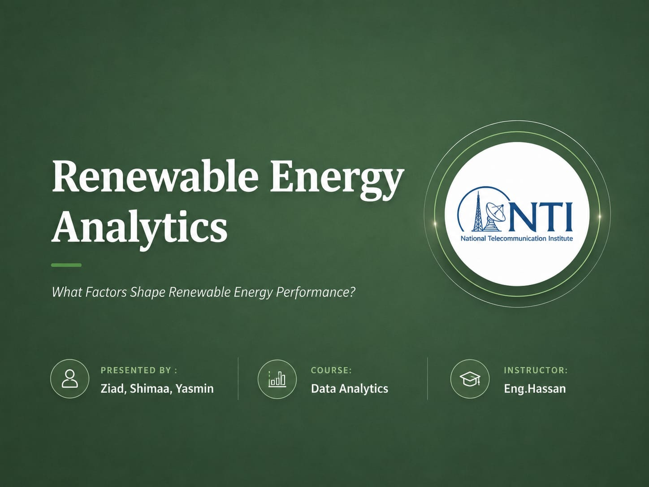

Slide 2
INTRODUCTION
Introduction to Renewable Energy
Renewable energy is energy generated from natural resources that are naturally replenished.
SOL
WND
HYD
BIO
GEO
Solar Energy
Wind Energy
Hydropower
Biomass
Geothermal Energy
RENEWABLE ENERGY HELPS
Reduce carbon emissions
Protect the environment
Support sustainable development
Reduce dependence on fossil fuels
Meet future energy demands
Although renewable energy is growing worldwide, renewable energy performance still varies between countries.
RENEWABLE ENERGY ANALYTICS
02

Slide 3
PROBLEM STATEMENT
Problem Statement
Countries around the world are investing heavily in renewable energy.
However, renewable energy performance still differs from one country to another because of economic, environmental, and governmental factors.
THE BUSINESS QUESTION
“What Factors Shape Renewable
Energy Performance?”
RENEWABLE ENERGY ANALYTICS
03

Slide 4
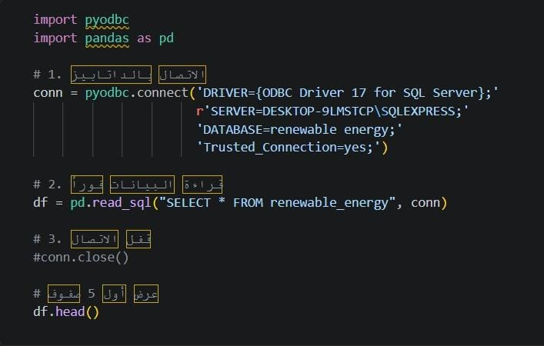
DATA ENGINEERING
Connecting Python with SQL Server
SQL
Why We Connected Python to SQL
Before analyzing the dataset, Python was connected to SQL Server using pyodbc.
IMAGE / SCREENSHOT PLACEHOLDER
SQL Connection Code Screenshot
Access the database directly
Execute SQL queries
Retrieve data efficiently
Perform data analysis using Python
Insert the pyodbc connection code screenshot here
RENEWABLE ENERGY ANALYTICS
04

Slide 5
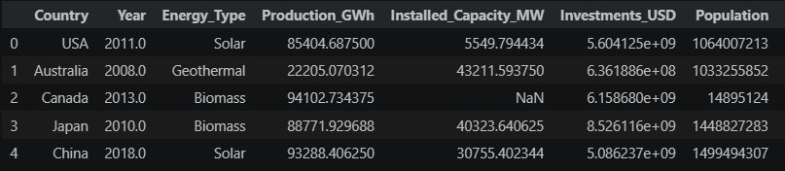
DATA FOUNDATION
Dataset Overview
Dataset Description
Contains renewable energy information from multiple countries, including:
IMAGE / SCREENSHOT PLACEHOLDER
First Five Rows of Dataset
Country
Year
Energy Type
Production
Investments
GDP
CO₂ Emissions
Government Policies
Innovation Indicators
Natural Resources
Insert dataframe .head() screenshot here
Kaggle
2,500
60
SQL Server
SOURCE
ROWS
COLUMNS
DATABASE
RENEWABLE ENERGY ANALYTICS
05

Slide 6
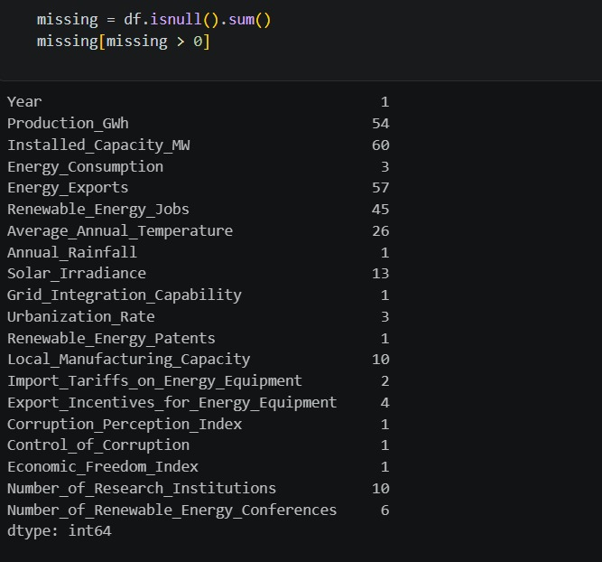
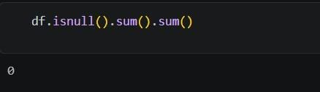
DATA ENGINEERING
Data Preparation
IMAGE / SCREENSHOT PLACEHOLDER
IMAGE / SCREENSHOT PLACEHOLDER
→
Before Cleaning
After Cleaning
Raw dataset screenshot
Cleaned dataset screenshot
CLEANING PROCESS
Handling Missing Values
Removing unnecessary data
Checking data quality
Preparing the dataset for visualization
Preparing the dataset for machine learning
The cleaned dataset became accurate and reliable for analysis.
RENEWABLE ENERGY ANALYTICS
06

Slide 7
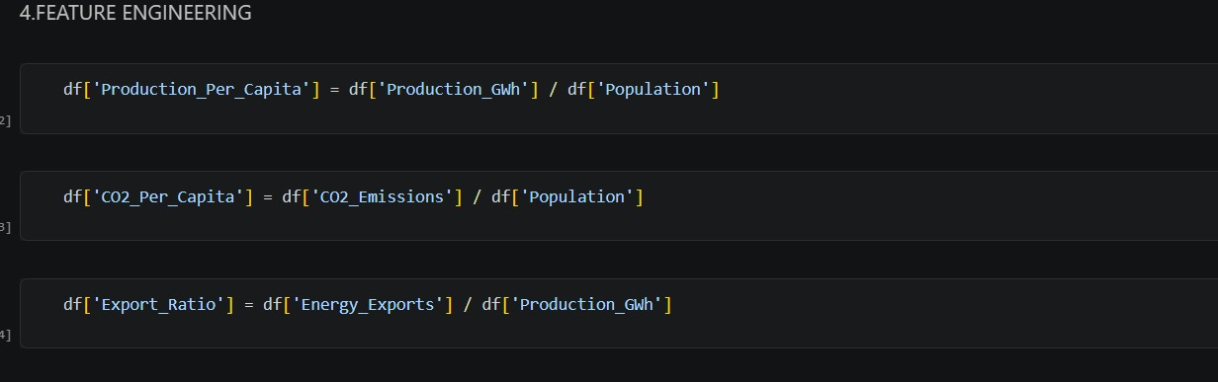
DATA ENGINEERING
Feature Engineering
IMAGE / SCREENSHOT PLACEHOLDER
Newly Created Columns
Screenshot of engineered feature columns
⊕
⊕
⊕
Production Per Capita
CO₂ Per Capita
Export Ratio
Normalizes output relative to population size
Measures environmental impact per person
Share of production directed to export markets
These features provided deeper insights into renewable energy performance.
RENEWABLE ENERGY ANALYTICS
07

Slide 8
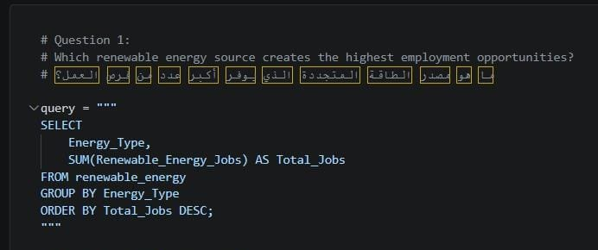
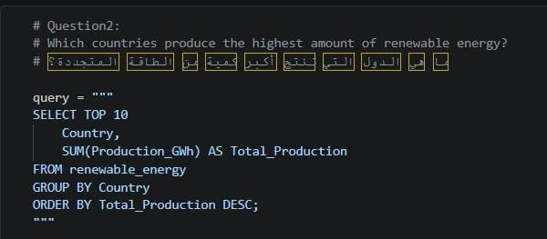
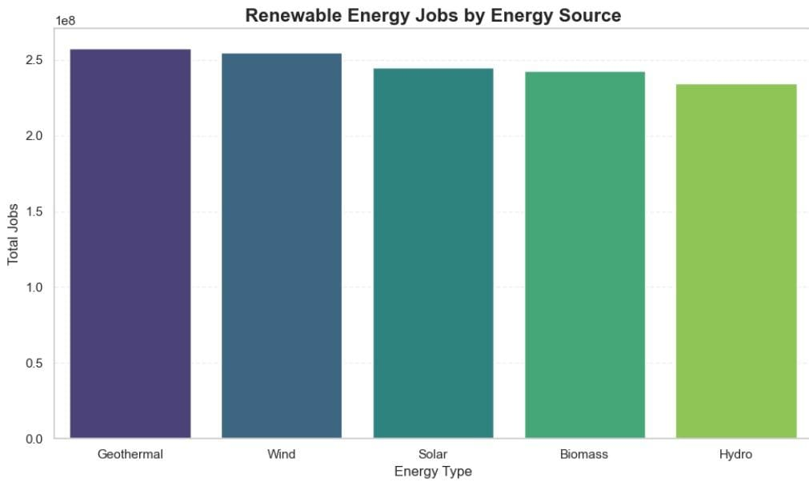
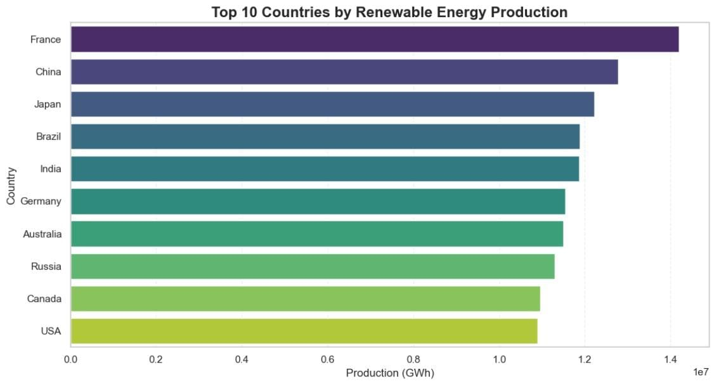
SQL ANALYSIS
Business Questions Using SQL
QUESTION 1
QUESTION 2
IMAGE / SCREENSHOT PLACEHOLDER
IMAGE / SCREENSHOT PLACEHOLDER
SQL Query
SQL Query
Query for Question 1
Query for Question 2
IMAGE / SCREENSHOT PLACEHOLDER
IMAGE / SCREENSHOT PLACEHOLDER
Output Chart
Output Chart
Chart for Question 1
Chart for Question 2
Geothermal energy leads in total job creation, closely followed by Wind, Solar, and Biomass, while Hydro energy accounts for the lowest share of employment among renewable sources.
France ranks highest in total renewable energy production, followed by China and Japan, whereas the USA and Canada record the lowest production levels among the top 10 countries
RENEWABLE ENERGY ANALYTICS
08

Slide 9
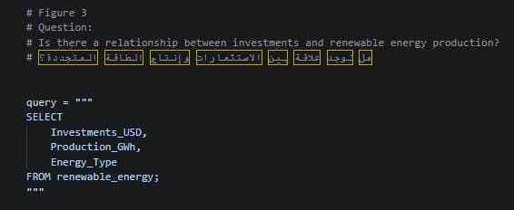
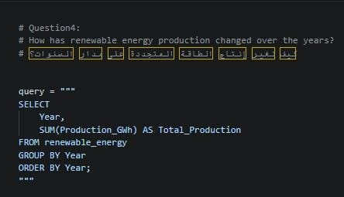
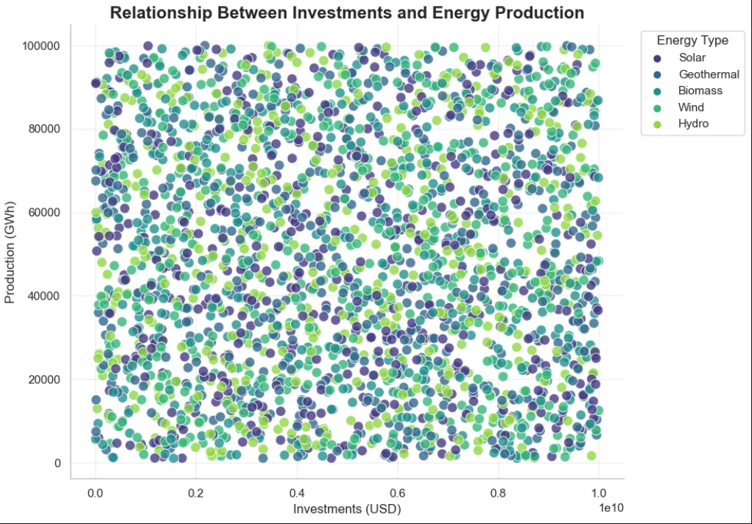
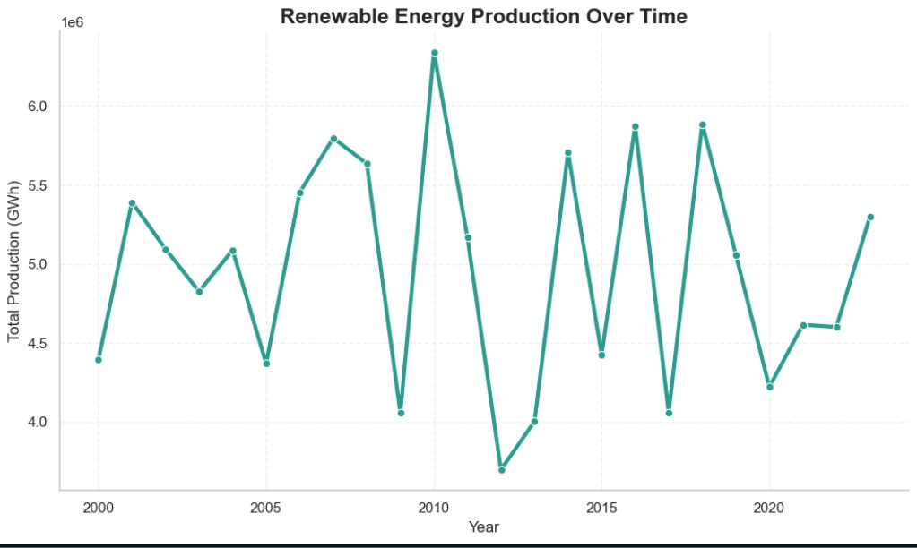
SQL ANALYSIS
Business Questions Using SQL
QUESTION 3
QUESTION 4
IMAGE / SCREENSHOT PLACEHOLDER
IMAGE / SCREENSHOT PLACEHOLDER
SQL Query
SQL Query
Query for Question 3
Query for Question 4
IMAGE / SCREENSHOT PLACEHOLDER
IMAGE / SCREENSHOT PLACEHOLDER
Output Chart
Output Chart
Chart for Question 3
Chart for Question 4
The scatter plot shows a uniform distribution across all energy types, indicating no strong linear correlation between financial investment levels and total energy output.
Total renewable energy production exhibits significant annual fluctuations from 2000 to 2023, reaching its peak around 2010 before stabilizing into cyclic highs and lows.
RENEWABLE ENERGY ANALYTICS
09

Slide 10
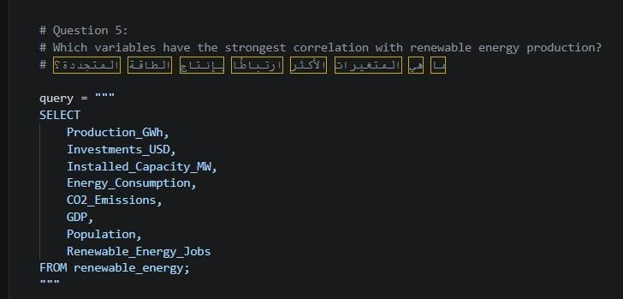
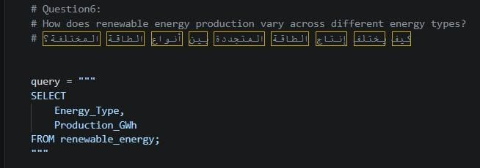
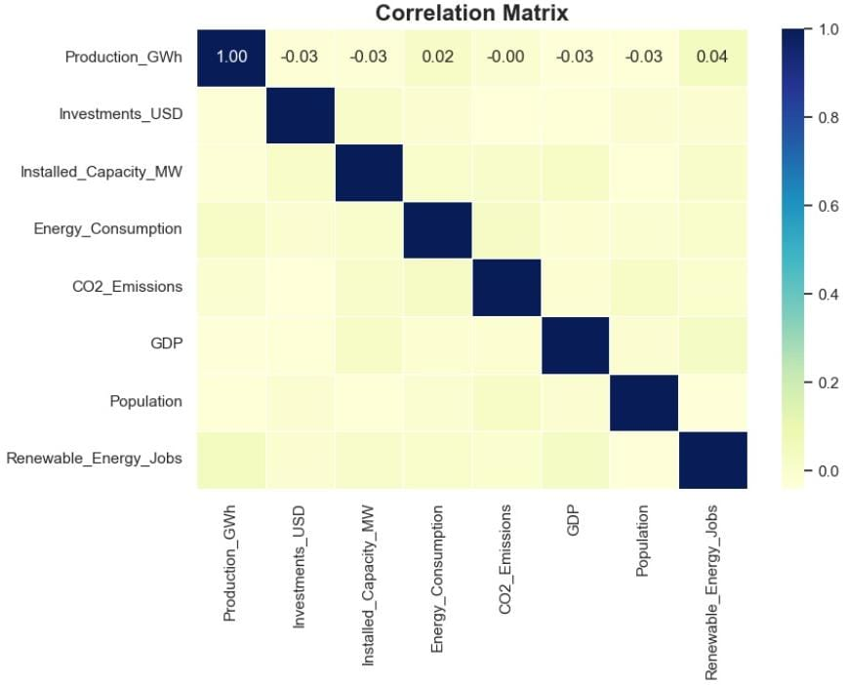
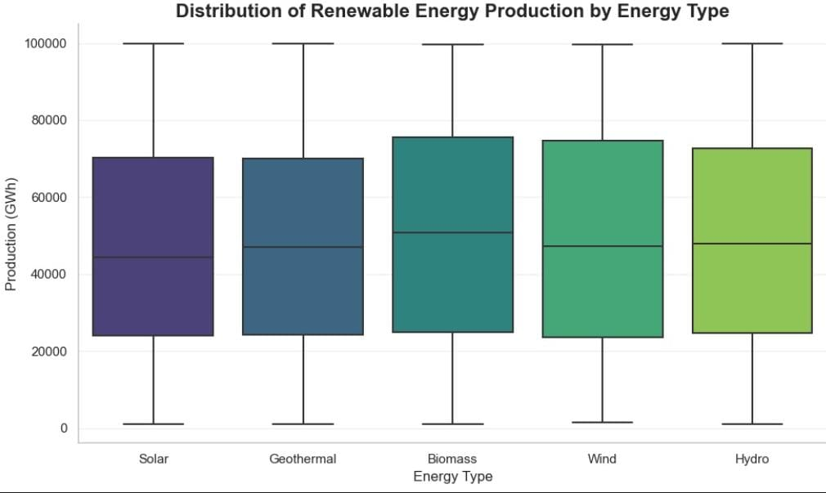
SQL ANALYSIS
Business Questions Using SQL
QUESTION 5
QUESTION 6
IMAGE / SCREENSHOT PLACEHOLDER
IMAGE / SCREENSHOT PLACEHOLDER
SQL Query
SQL Query
Query for Question 5
Query for Question 6
IMAGE / SCREENSHOT PLACEHOLDER
IMAGE / SCREENSHOT PLACEHOLDER
Output Chart
Output Chart
Chart for Question 5
Chart for Question 6
The correlation matrix reveals virtually no linear correlation among the numeric variables, with all pairwise correlation coefficients staying extremely close to zero (between -0.03 and 0.04).
The energy production range is evenly distributed across all renewable types, with Biomass displaying a slightly higher median production than the other sources.
The SQL analysis answered important business questions and provided valuable insights before moving to predictive analytics.
RENEWABLE ENERGY ANALYTICS
10

Slide 11
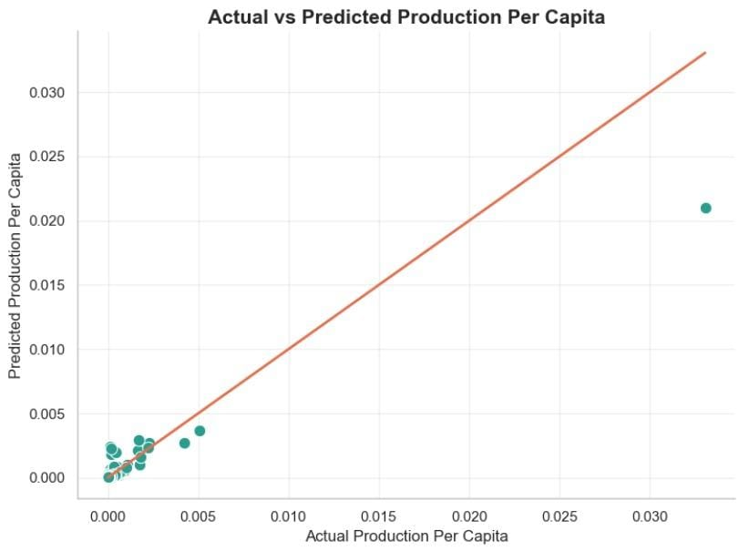
PREDICTIVE ANALYTICS
Renewable Energy Prediction
Machine learning was used to predict renewable energy performance using the available indicators.
X VARIABLES
Y VARIABLE
Production_Per_Capita
,
Installed_Capacity_MW, Investments_USD
Population,GDP, Energy_Consumption, Renewable_Energy_Jobs, Solar_Irradiance
TRAIN / TEST SPLIT
MODEL
[e.g. 80% / 20%]
Random Forest Regressor
IMAGE / SCREENSHOT PLACEHOLDER
Prediction Graph
Actual vs. predicted output visualization
ACCURACY
EVALUATION SCORE
85%
[R² / RMSE / MAE]
RENEWABLE ENERGY ANALYTICS
11

Slide 12
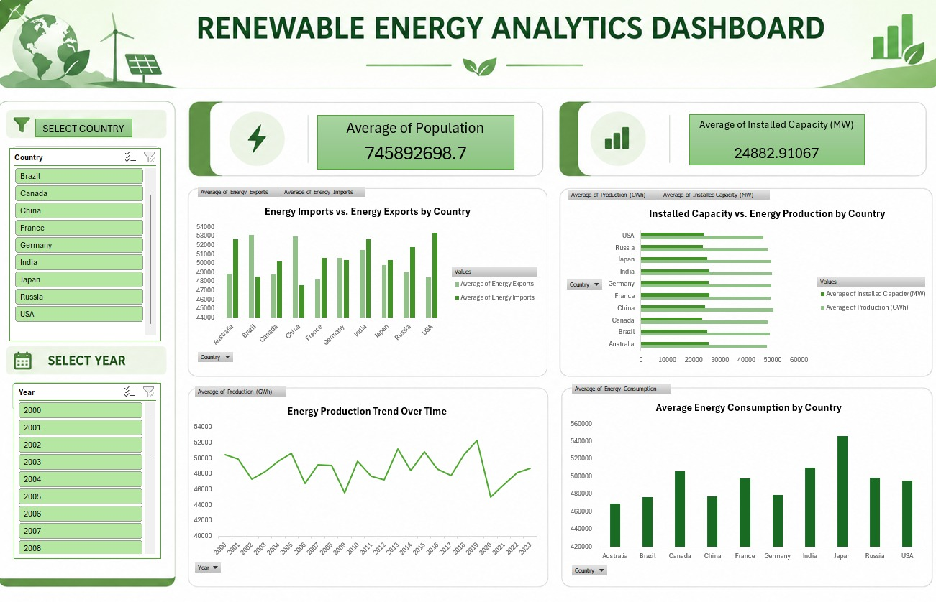
BUSINESS INTELLIGENCE
Excel Analytical Dashboard — Part 1
This dashboard provides deeper renewable energy analysis, enabling country comparison and indicator analysis.
HIGHLIGHTS
Country Comparison
Indicator Analysis
Deep-Dive Filtering
Trend Exploration
IMAGE / SCREENSHOT PLACEHOLDER
Excel Analytical Dashboard — overview
Insert dashboard screenshot here
RENEWABLE ENERGY ANALYTICS
15

Slide 13
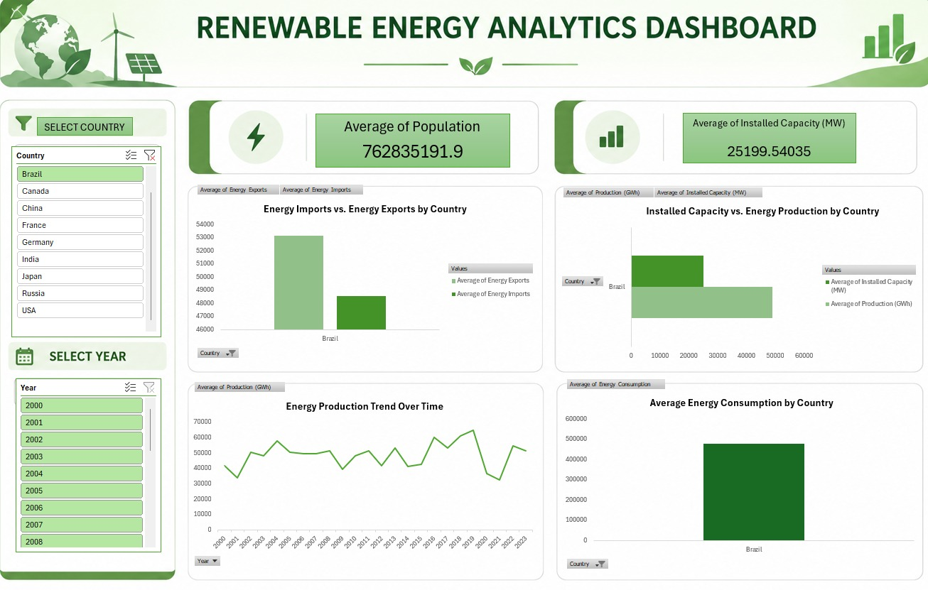
BUSINESS INTELLIGENCE
Excel Analytical Dashboard — Part 2
HIGHLIGHTS
Advanced Charts
Analysis
Interactive Features
IMAGE / SCREENSHOT PLACEHOLDER
Excel Analytical Dashboard — advanced charts
Insert dashboard screenshot here
RENEWABLE ENERGY ANALYTICS
16

Slide 14
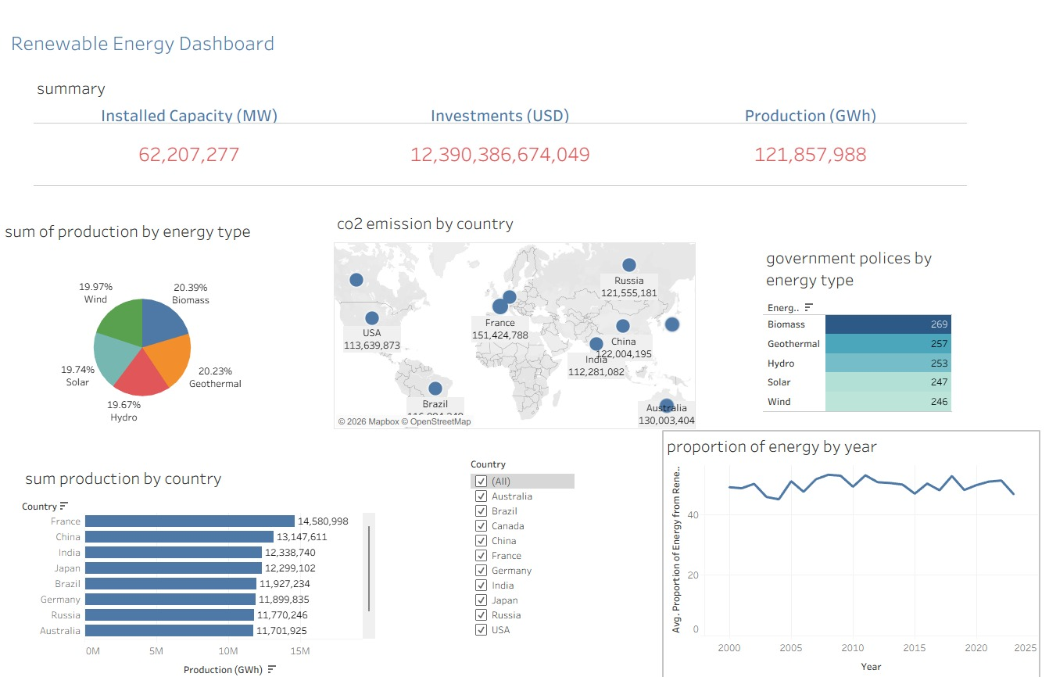
BUSINESS INTELLIGENCE
Tableau Dashboard — Part 1
The Tableau dashboard provides advanced interactive visualizations with dynamic filtering.
HIGHLIGHTS
Advanced Visualizations
Dynamic Filtering
Cross-Country Insights
IMAGE / SCREENSHOT PLACEHOLDER
Tableau Dashboard — overview
Insert dashboard screenshot here
RENEWABLE ENERGY ANALYTICS
17

Slide 15
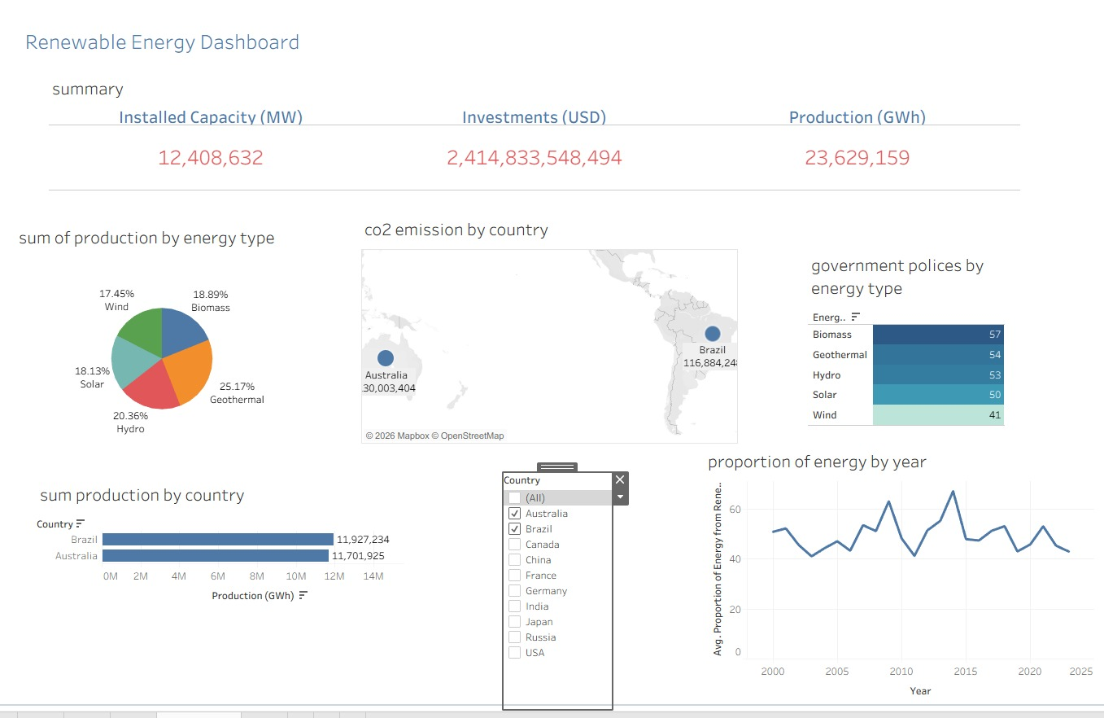
BUSINESS INTELLIGENCE
Tableau Dashboard — Part 2
HIGHLIGHTS
Interactive Filters
User Exploration
Dynamic Visualizations
IMAGE / SCREENSHOT PLACEHOLDER
Tableau Dashboard — interactive view
Insert dashboard screenshot here
RENEWABLE ENERGY ANALYTICS
18

Slide 16
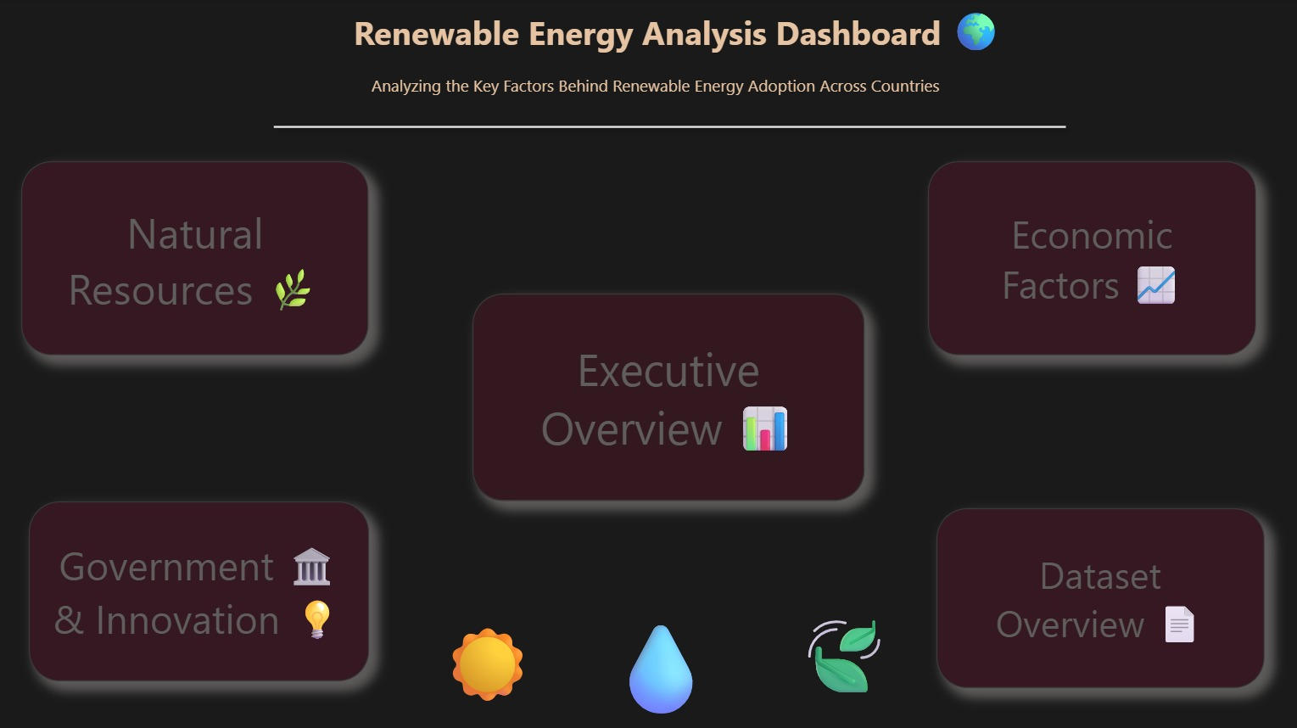
BUSINESS INTELLIGENCE
Power pi Analytical Dashboard Overview
IMAGE / SCREENSHOT PLACEHOLDER
Dashboard Suite Overview
Combined / hero screenshot of the three dashboards
XL
Excel Executive Dashboard
Excel Analytical Dashboard
TB
Tableau Dashboard
RENEWABLE ENERGY ANALYTICS
12

Slide 17
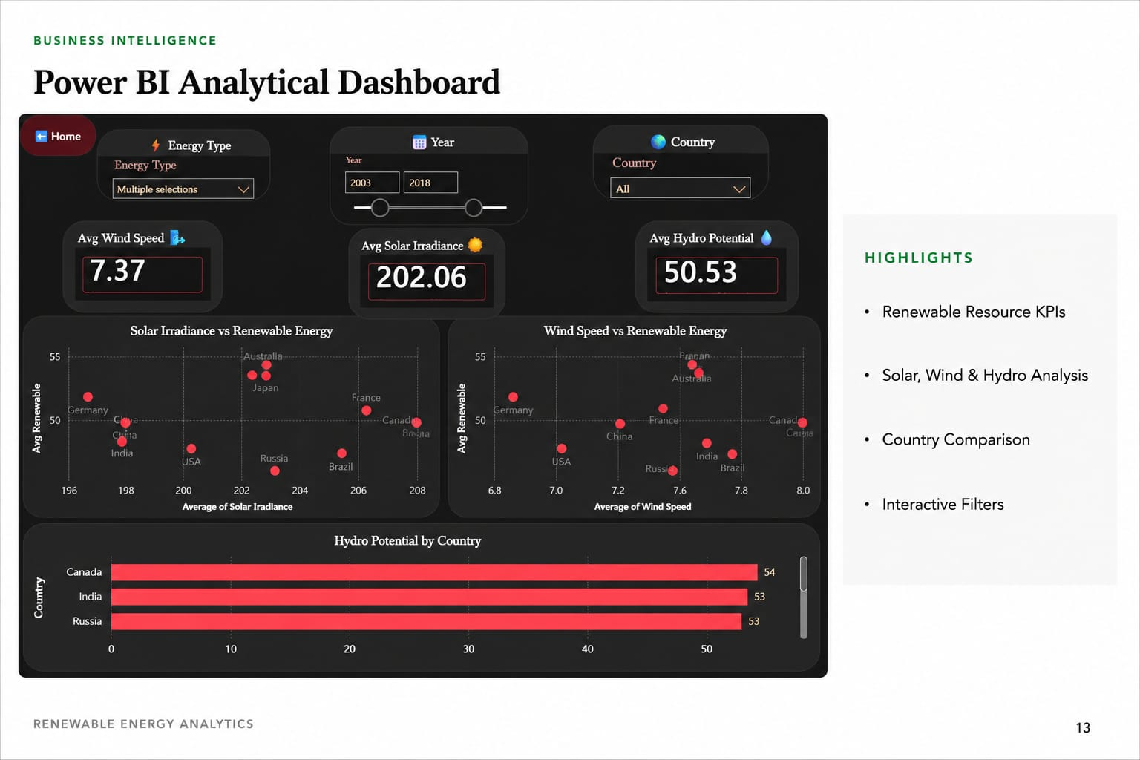

Slide 18
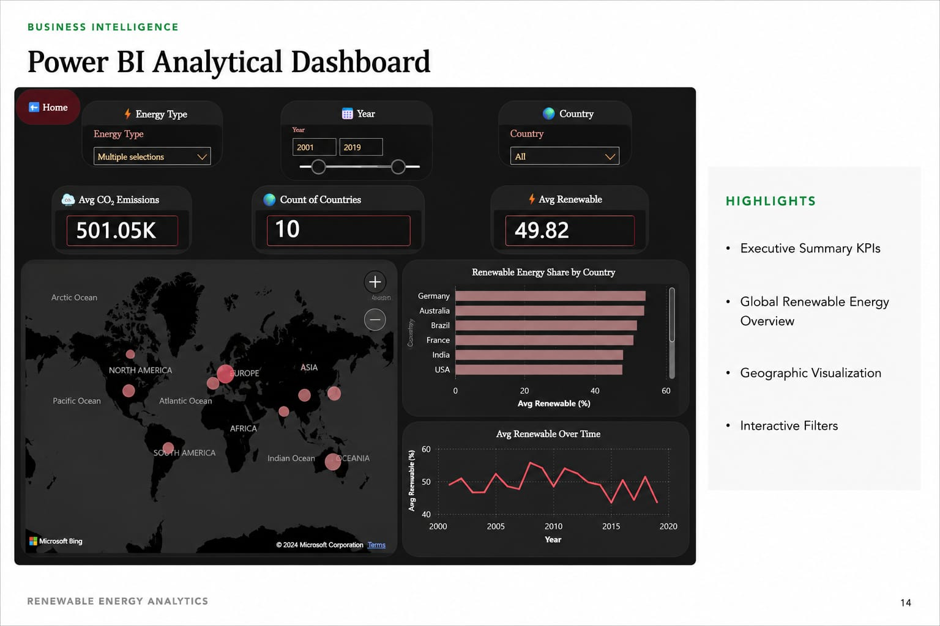

Slide 19
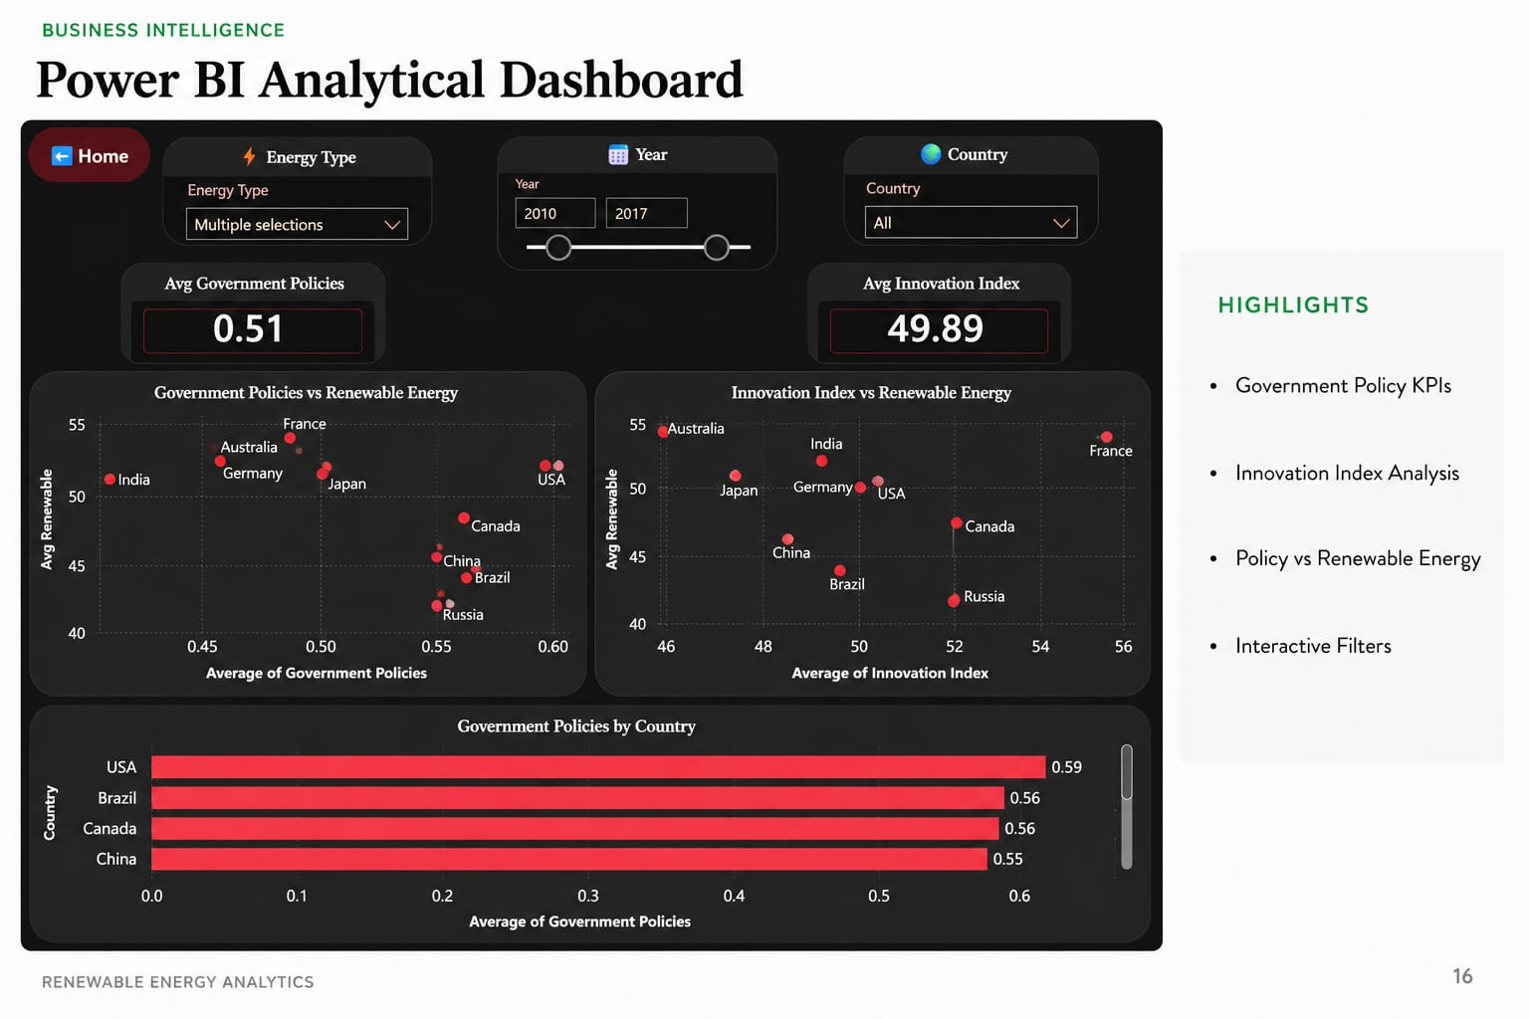

Slide 20
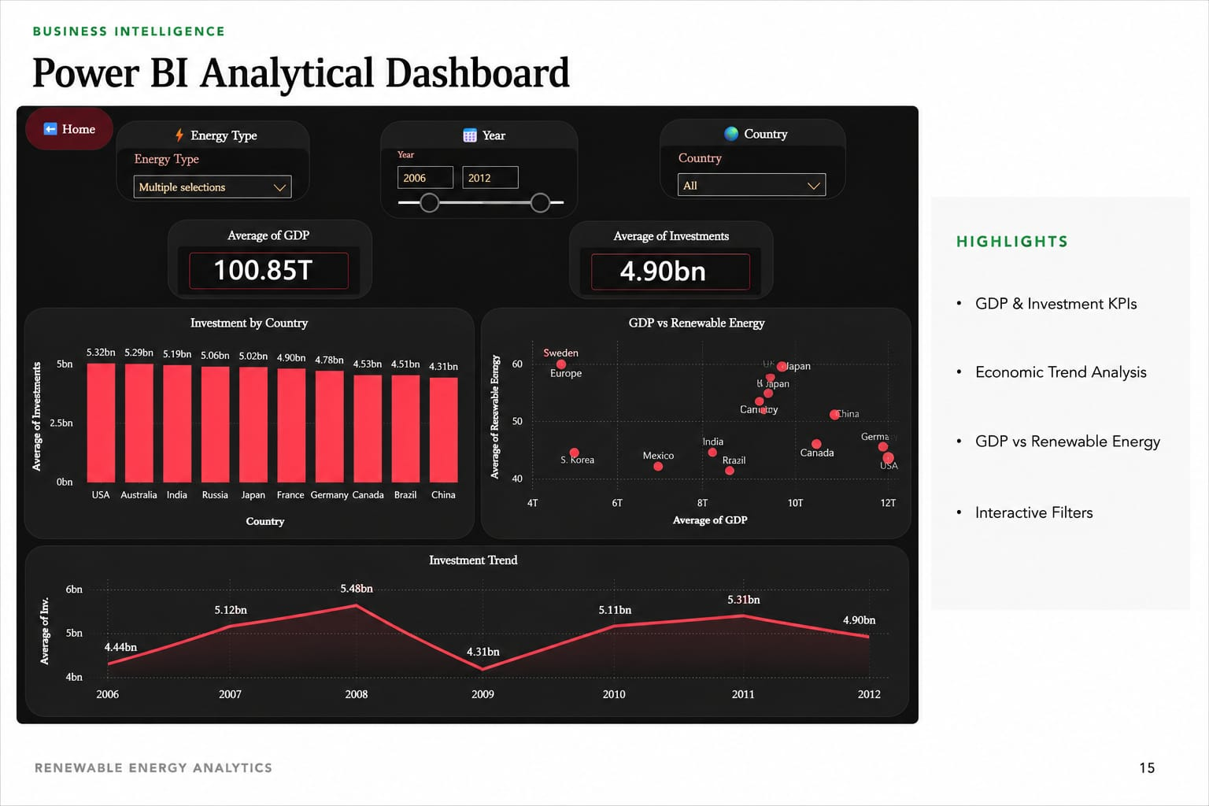

Slide 21
RESULTS
Final Findings
01
Renewable energy performance differs across countries.
02
Investments positively influence renewable energy performance.
03
Natural resources contribute to renewable energy development.
04
Government policies support renewable energy growth.
05
Interactive dashboards simplify business analysis.
RENEWABLE ENERGY ANALYTICS
19

Slide 22
SUMMARY
Project Insights
PY
SQL
ML
BI
Python
SQL
Machine Learning
Dashboards
Prepared and cleaned the data.
Answered important business questions.
Predicted renewable energy performance.
Transformed raw data into interactive business insights.
RENEWABLE ENERGY ANALYTICS
20

Slide 23
CONCLUSION
Answering the Business Question
“What Factors Shape Renewable Energy Performance?”
Investments
Economic Indicators
Natural Resources
Government Policies
Innovation
Renewable energy performance is influenced by a combination of these factors, which collectively support better decision-making.
RENEWABLE ENERGY ANALYTICS
21

Slide 24
NEXT STEPS
Recommendations
01
02
03
Increase renewable energy investments.
Improve government policies.
Encourage innovation and research.
04
05
Expand renewable energy infrastructure.
Continue using Business Intelligence tools to monitor renewable energy performance.
RENEWABLE ENERGY ANALYTICS
22

Slide 25


